Slide 1
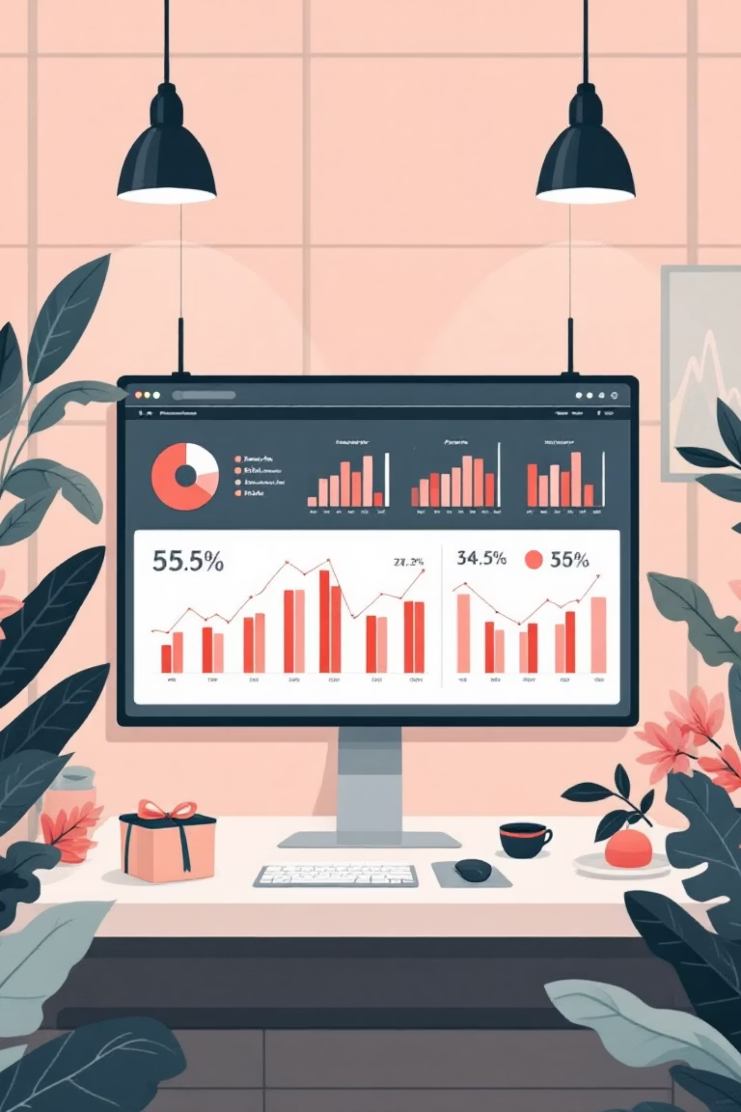
Shopping Trend Analysis
Transforming customer purchasing behavior into actionable business insights through comprehensive data analytics

Slide 2
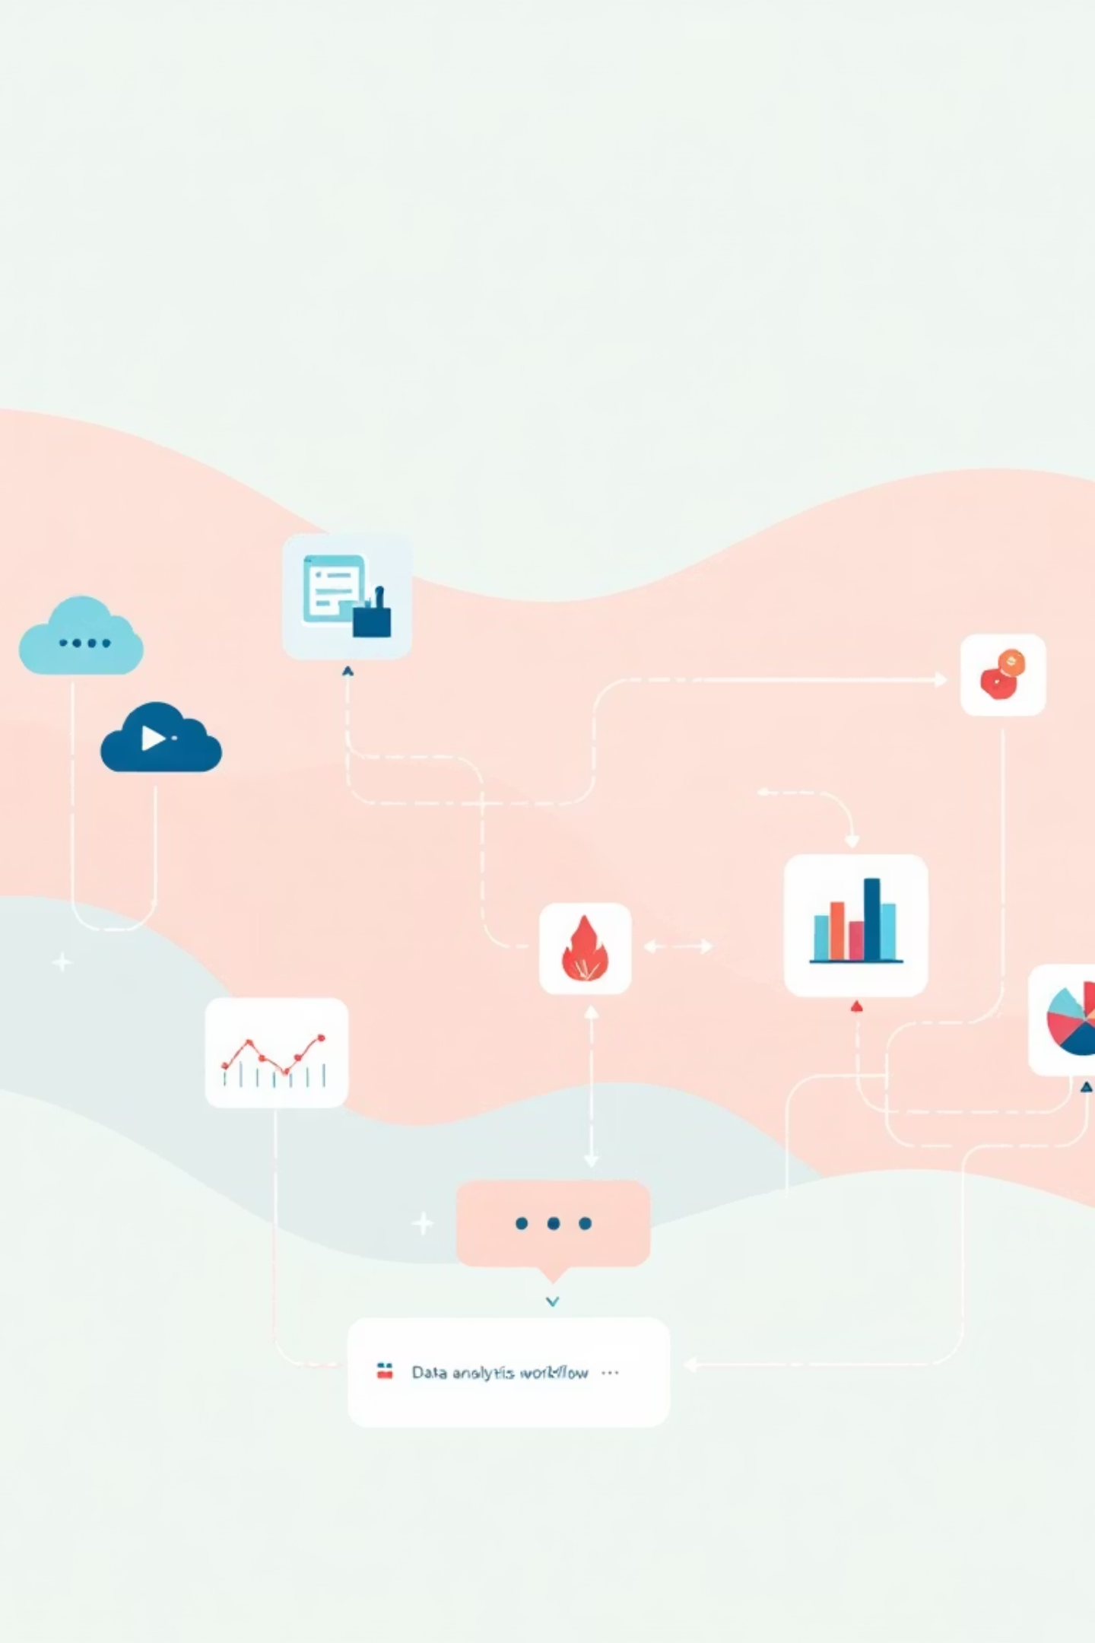



Project Overview
Objective
Technology Stack
Understand customer purchasing behavior, revenue patterns, and financial performance to drive data-driven decisions
Excel, Python, SQL, and BI dashboards integrated for end-to-end analysis
Business Impact
Support marketing strategy, customer segmentation, inventory planning, and revenue optimization

Slide 3

Dataset Overview
Key Attributes
3,900
Customer demographics (Age, Gender, Location)
Total Rows
Product category and seasonal trends
Purchase amount and payment methods
18
Promotional usage and subscriptions
Data Columns
Review ratings and purchase history

Slide 4
Data Cleaning with Excel
01
02
03
Duplicate Removal
Standardization
Data Validation
Eliminated duplicate records using Remove Duplicates feature
Unified column names and text formats for consistency
Checked for missing values and inconsistencies
04
05
Type Conversion
Category Consistency
Converted numerical columns to correct data types
Ensured categorical data uniformity across Gender, Season, Payment Method

Slide 5
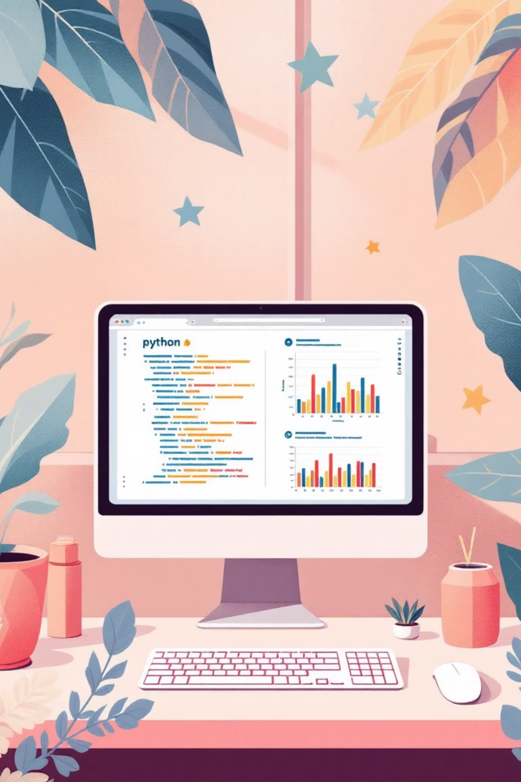
Exploratory Data Analysis
Descriptive Statistics
Data Processing
Mean: Average purchase amount and review rating
Created new analytical columns
Median: Central tendency of spending behavior
Handled missing data with mean/median/mode imputation
Mode: Most common category, season, payment method
Verified data integrity post-cleaning
Standard Deviation: Variability in purchase amounts

Slide 6




Predictive Modeling
Data Preparation
Split dataset into training and testing sets
Model Training
Applied Linear Regression to predict purchase amounts
Validation
Evaluated model performance using R² score and residual analysis
Independent variables included age, previous purchases, and review ratings to forecast customer spending behavior

Slide 7
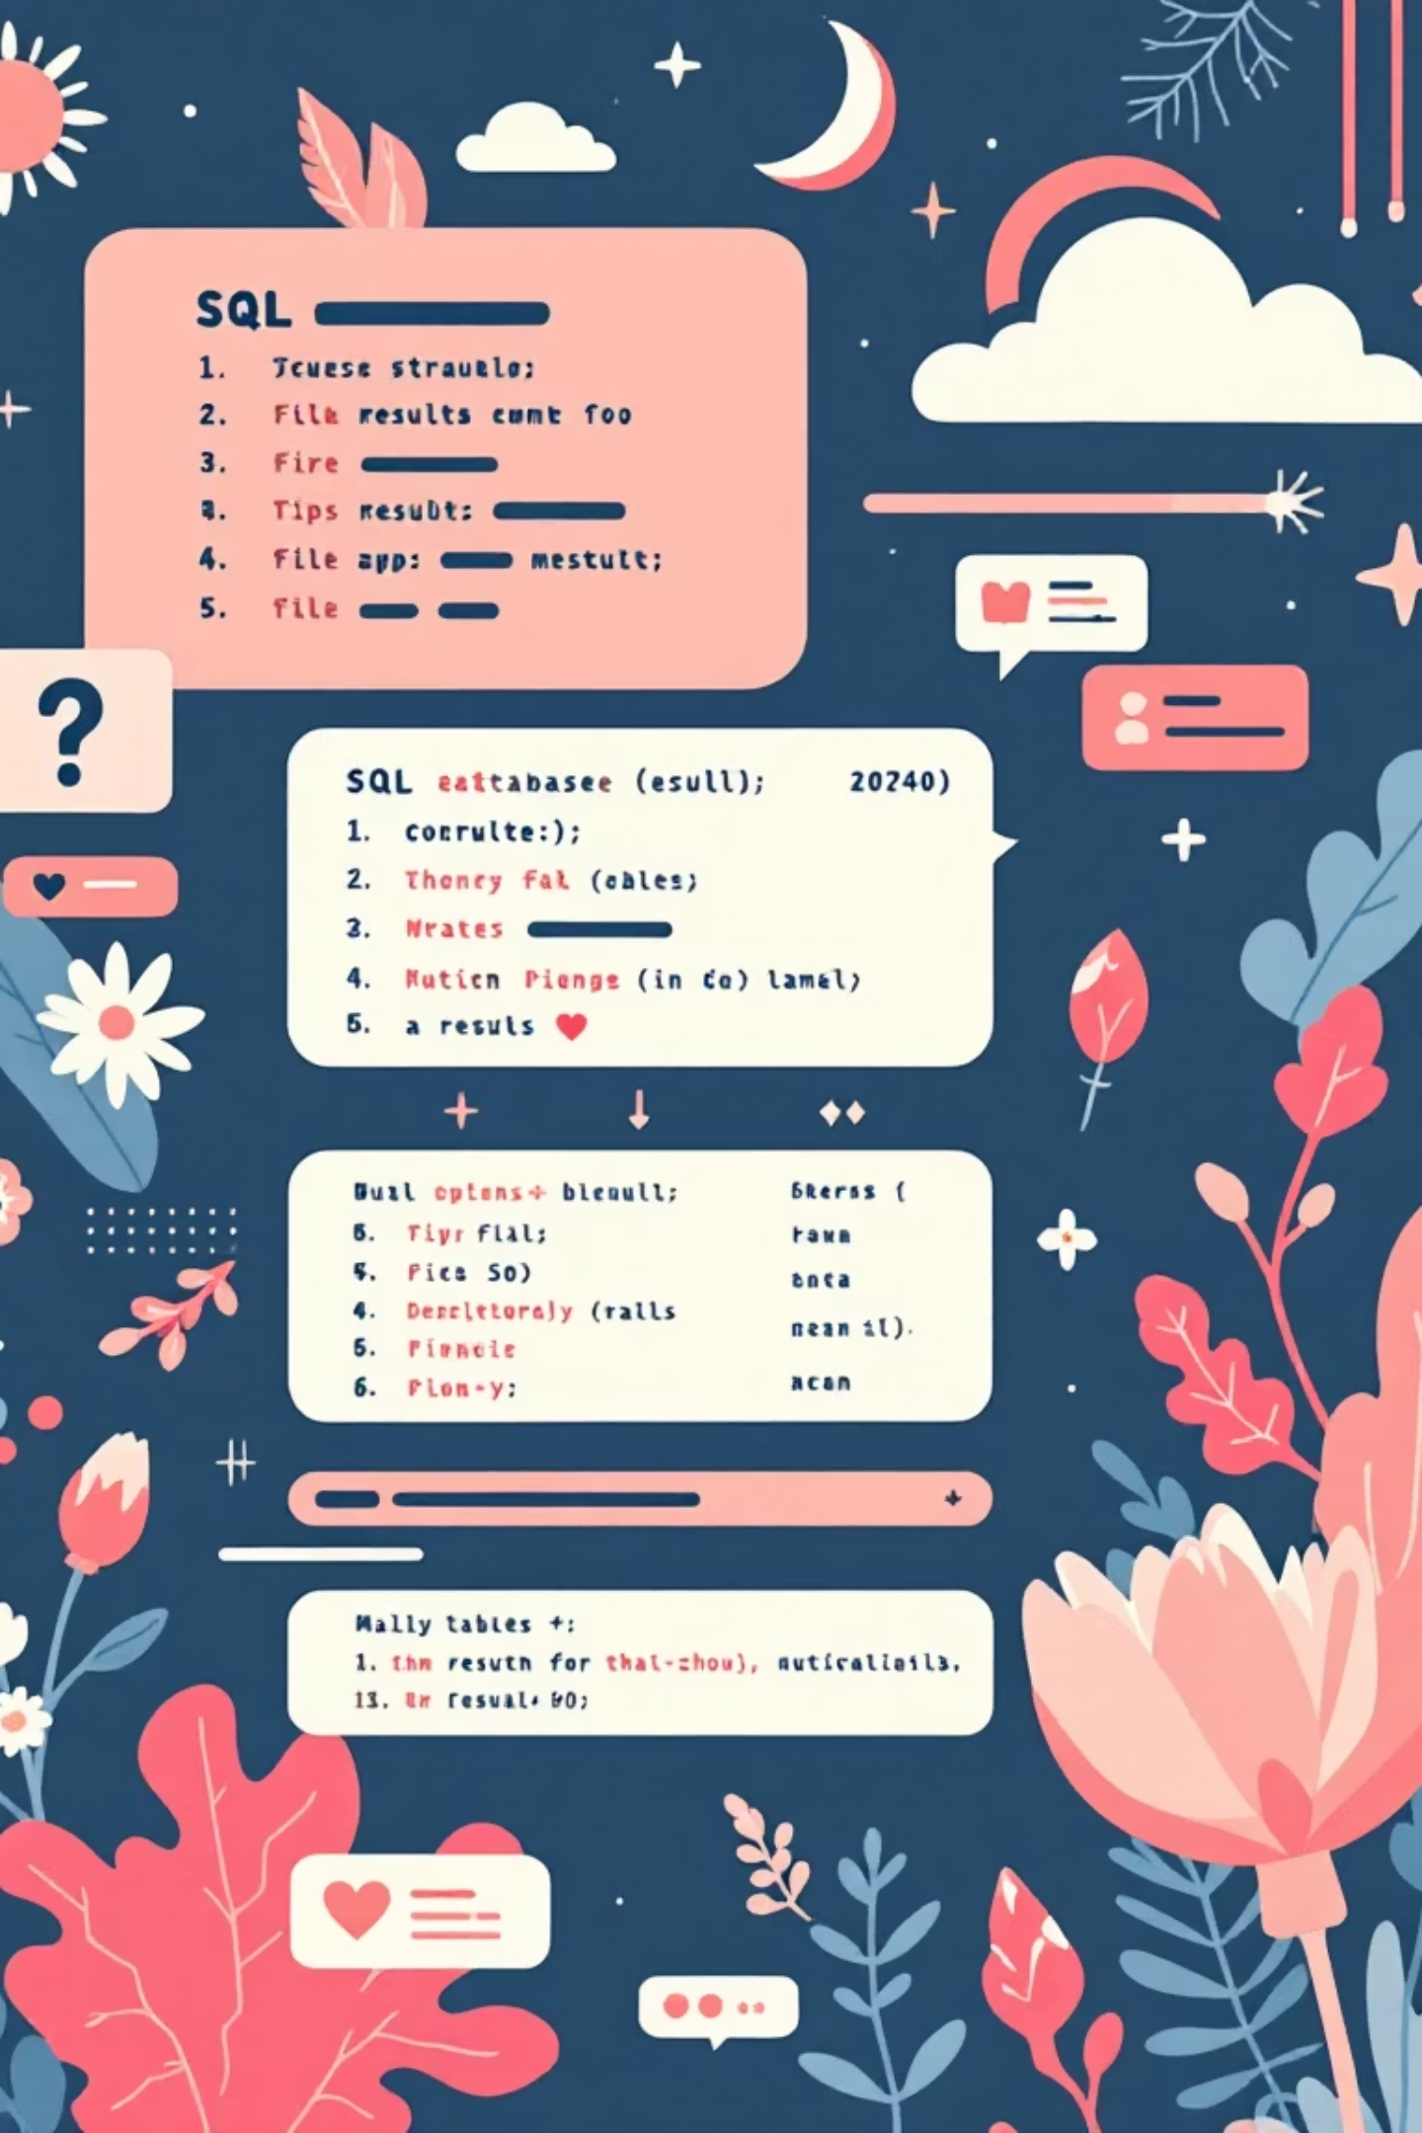
SQL Database Analysis
Database Operations
Business Queries
CREATE DATABASE and TABLE structures
19 objective-based SQL queries implemented:
INSERT, UPDATE, DELETE records
Revenue calculations by category and season
ADD and DROP columns dynamically
Customer segmentation analysis
Aggregate functions (SUM, AVG, COUNT, MAX, MIN)
Top revenue-generating customers
Payment method trends

Slide 8
Interactive BI Dashboards
Shopping Trends
Purchase Details
Finance Insights
Category-wise sales, seasonal patterns, and customer demographics overview
Customer behavior, payment analysis, and promo code usage trends
Total revenue, average purchase value, and high-value customer identification

Slide 9
Business Recommendations
Marketing Focus
Subscription Growth
Promo Optimization
Concentrate efforts on high-revenue categories and peak seasonal periods
Promote subscription plans to increase repeat purchases and customer lifetime value
Refine promotional strategies based on customer response patterns
Personalization
Inventory Planning
Target high-value customers with tailored offers and experiences
Optimize stock levels using seasonal demand trend forecasts

Slide 10

Project Impact
The Shopping Trend Analysis project demonstrates effective integration of Excel, Python, SQL, and BI tools to transform raw data into actionable insights.
Statistical Analysis
Comprehensive EDA revealing customer patterns
Predictive Modeling
Linear regression forecasting purchase behavior
Structured Querying
19 SQL queries supporting business decisions
Visual Dashboards
Interactive insights for stakeholders
This end-to-end analysis provides strong business value and supports strategic decision-making in retail and e-commerce environments.

